Slide 1

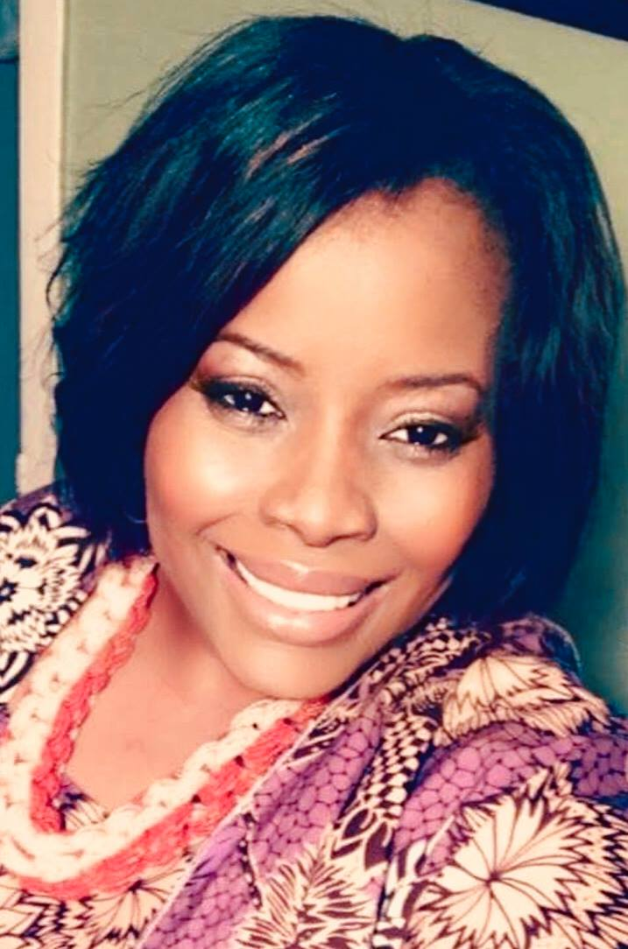
Apostle Glenda R. Phillips Lee,
International Gospel Helpers Church Inc. NYC
Restoring the Order of Original Love
ACLC Prayer Breakfast and True Families Values Presentation
“Biblical Perspectives on God’s Ideal for Us”
Session 3 “WHAT WENT WRONG”
Host Pastor Rev. Hopton Scott
Location: First Baptist Church
126 Washington Ave, Bridgeport, CT
Saturday, February 16, 2019
9am to Noon
Donation: $10
Please call Brother Antonio 203-583-2019 for more information

